Slide 1







FIFA WORLD CUP
Veljko Blagojević 0353/2019 Fizički projekat IS
Fakultet organizacionih nauka

Slide 2
FIFA WORLD CUP
Stadioni u Qataru
01
-
Al Bayt Stadium
02
-
Lusail Stadium
03
-
Ahmad Bin Ali Stadium
01
04
-
Education City Stadium
03
04
06
02
05
-
Khalifa International Stadium
05
07
06
-
Stadium 974
08
07
-
Al Thumama Stadium
08
-
Al Janoub Stadium

Slide 3
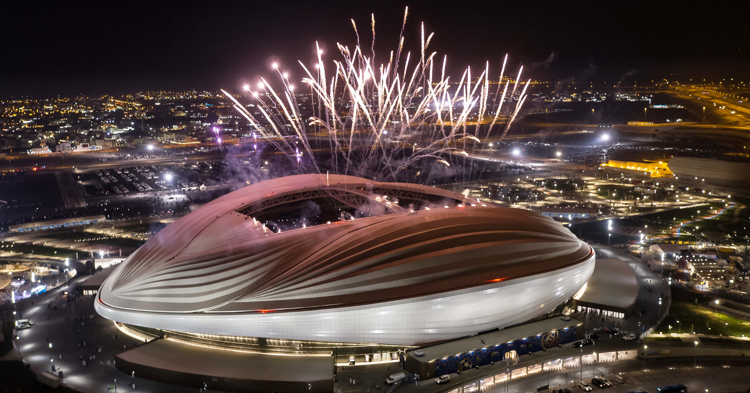
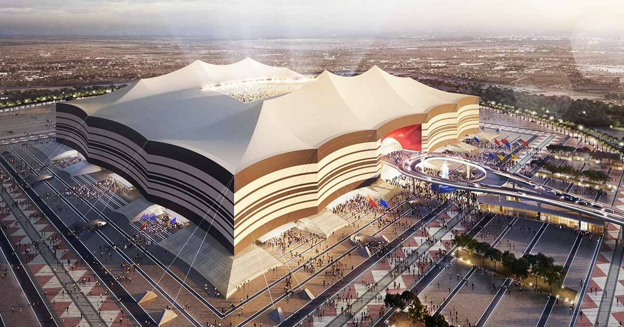
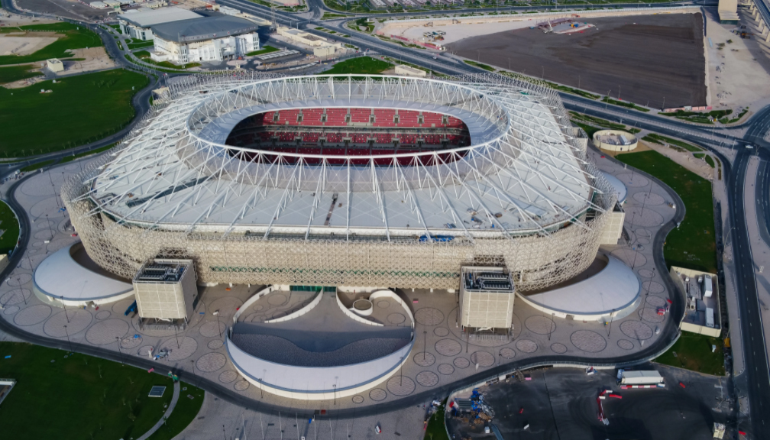
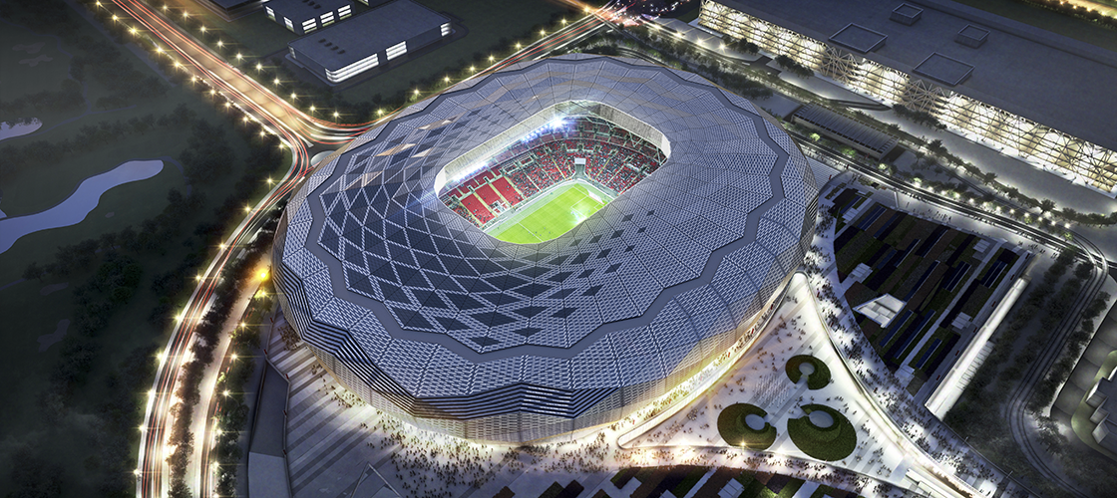
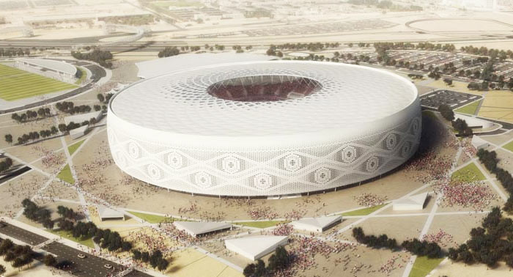
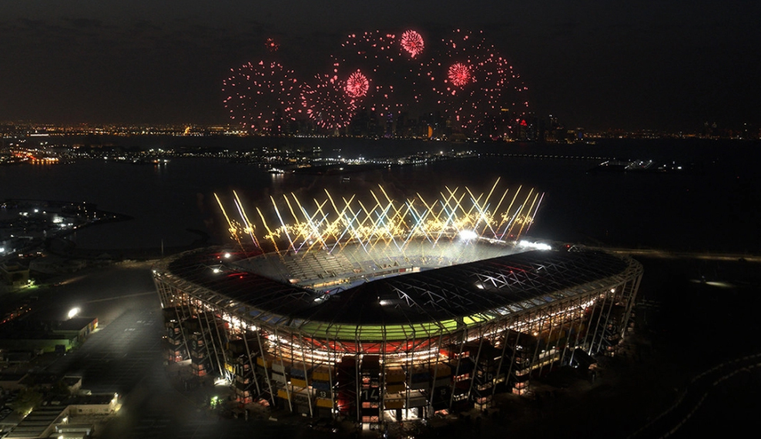
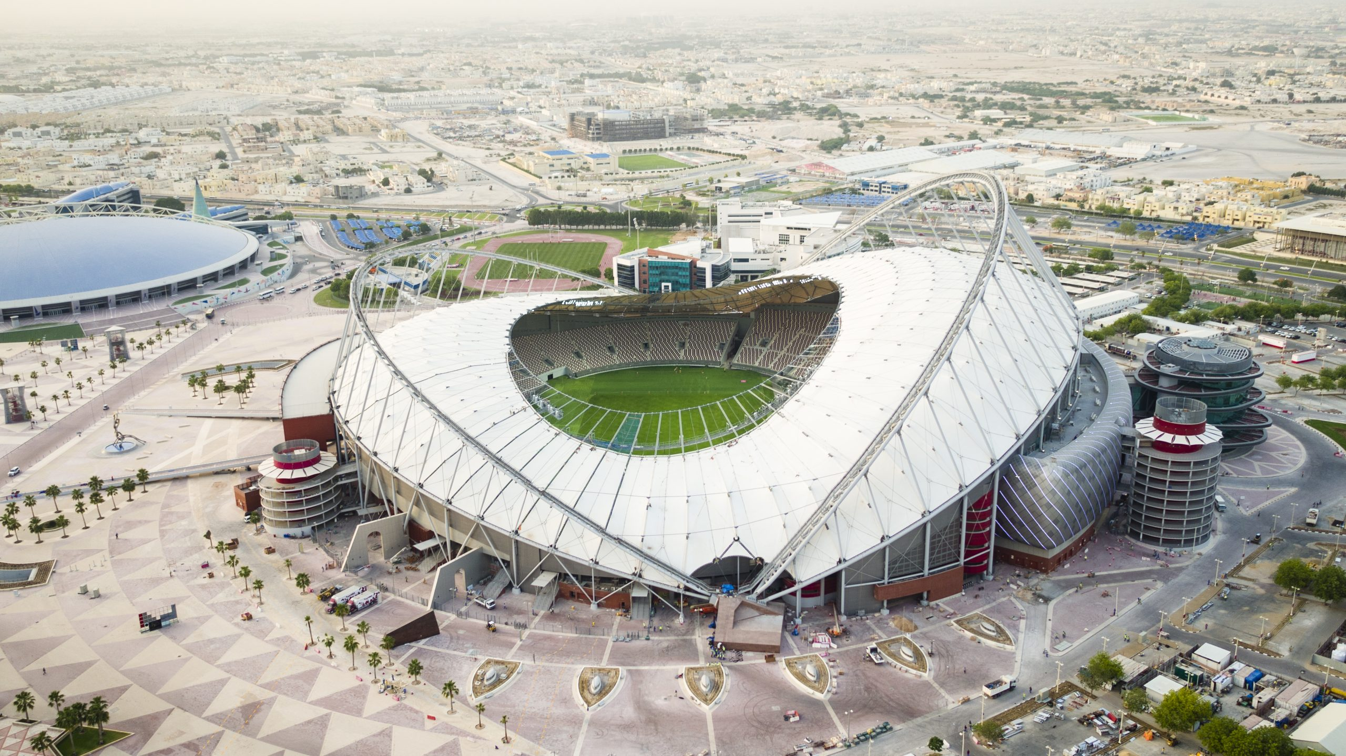
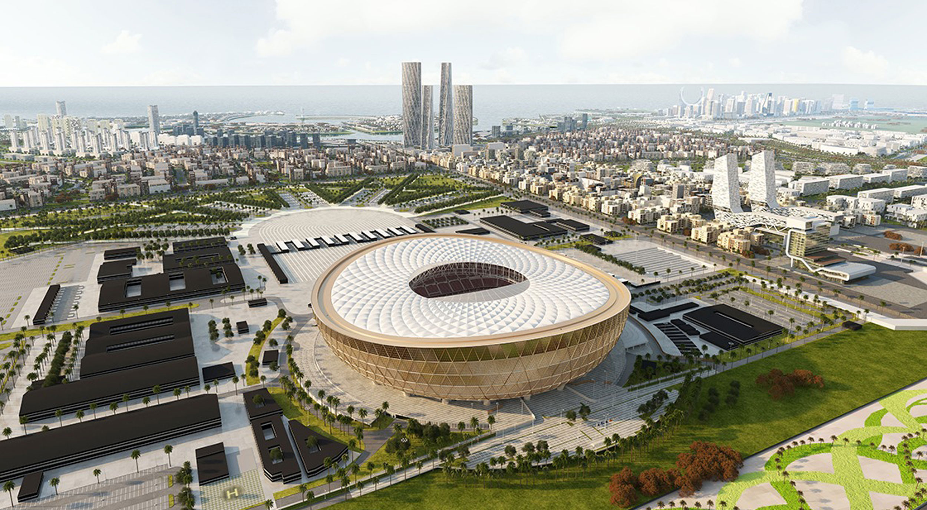
FIFA WORLD CUP
Stadioni u Qataru
Al Janoub
Al Bayt
Ahmad bin Ali
Education City
Al Thumama
Stadium 974
Khalifa International
Lusail

Slide 4

FIFA WORLD CUP
Seeder
Template method pattern
If(repo!=0) return;
abstract getStadioni();
repo.saveAll(stadioni);
<<abstract>>
StadionSeeder
InMemory
WebScraper

Slide 5
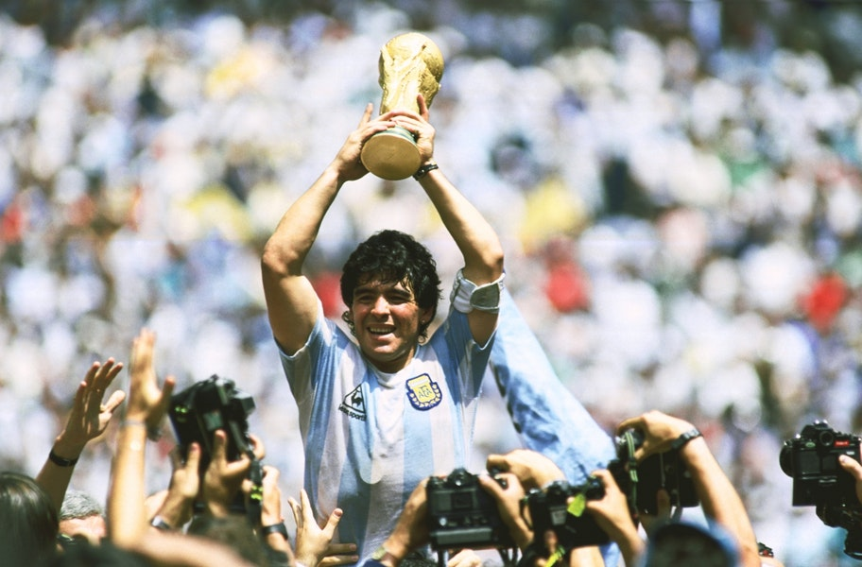
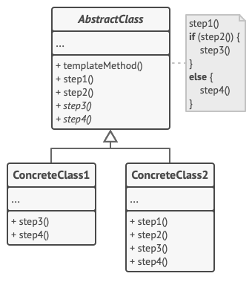
Template Method Pattern
FIFA WORLD CUP
Softverski patern ponašanja koji definiše skelet algoritma u nadklasi dok dopušta da podklase override-uju specifične korake algoritma bez promene njegove strukture

Slide 6

Web Scraping
FIFA WORLD CUP
Sakuplja podatke sa web stranice
Jednostavan program
Prolazak kroz DOM stablo
Automatizuje dosadne zadatke
Etički i legalni aspekt
JSoup je Java biblioteka za scrape

Slide 7
















Grupe i timovi
Svetsko prvenstvno u fudbalu 2022. će imati 32 tima podeljenih u 8 različitih grupa
Group A
Group B
Group C
Group D
Qatar
England
Argentina
France
Ecuador
IR Iran
Saudi Arabia
Australia
Senegal
USA
Mexico
Denmark
Netherlands
Wales
Poland
Tunisia
FIFA WORLD CUP

Slide 8
















Grupe i timovi
Group E
Group F
Group G
Group H
Spain
Belgium
Brazil
Portugal
Costa Rica
Canada
Serbia
Ghana
Germany
Morocco
Switzerland
Uruguay
Japan
Croatia
Cameroon
Korea Republic
FIFA WORLD CUP

Slide 9
HttpClient - API Web Service
CSVReader
FIFA WORLD CUP
Template method pattern
abstract izvlacenjeIzSesira()
<<abstract>>
Tombola
Seeder
Template method pattern
If(!repo.isEmpty()) return;
abstract getStadioni();
repo.saveAll(stadioni);
<<abstract>>
StadionSeeder
InMemory
WebScraper

Slide 10
Arhitektura
React TS SPA
Axios HttpClient
Apollo GraphQL Client
Troslojna arhitektura gde se veb aplikacija deli na frontend klijentski i backend serverski deo.
Svaki od datih slojeva se još dodatno raščlanjuje.
Java Spring Boot
Middleware
REST API Controller
GraphQL Controller
Validator
Service
Repository
FIFA WORLD CUP
MySQL

Slide 11
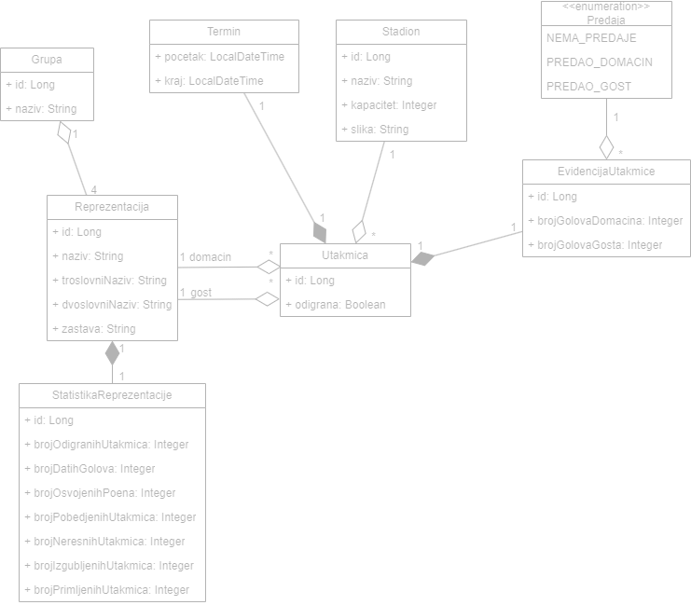
Domenski model
FIFA WORLD CUP

Slide 12
Funkcionalnosti
Strategy Pattern
Evidencija rezultata
Provera grupa, prethodnih utakmica, raspoloživosti
Zakazivanje utakmica
FIFA WORLD CUP

Slide 13
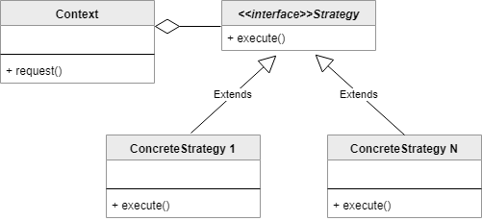
Strategy Pattern
Softverski patern ponašanja koji dopušta biranje algoritma u vreme izvršavanja
Konkretne strategije-podklase: Pobeda, Poraz, Nerešeneo

Slide 14
“Talk is cheap. Show me the code.”
-Linus Torvalds

